Slide 1
4 M’s Cause & Effect Diagram (Fishbone)
Manpower
Machines
IT Team
Data servers
Data Management
High Performance Workplace
Data Security
Resilience Management Process
Retest within 90 days
Data Recovery
Compliance Report
RTO
Prevention of Mismanagement
BIA
Measures
Methods

Slide 2
4 S’s Cause & Effect Diagram (Fishbone)
Surroundings
Suppliers
No support for advanced features
Poor service reliability
Complex to use
Low responsiveness
Brain drain
Reduced
competitiveness
Regarding
Technology
Poor functionality
Lack of abilities
Poor flexibility
Poor experience
Poor initial implementation
poor training
Systems
Skills
Notes:
Reduced Competitiveness Regarding Technology
The technology is very essential when dealing with the business systems or the ecommerce systems.
Surroundings
Surroundings refers to issues related to the environmental factors regarding technology that neither can be controlled by nor depend on e-Commerce firms.
There is lack of support for advanced features such as easy access to application details and warnings whenever changes are made to the system.
There is also complexity in handling the system because it requires highly qualified personnel who are used to the system.
It is brain draining especially to new users who are not used to it. They will need to train long enough to understand the system which is draining.
2. Systems
The aspect of Systems refers to all issues dealing with the physical devices equipment providing the required functionalities.
There exists poor functionality in regard to user interface. It has poor user friendliness.
It also exhibits poor flexibility due to its complexity of use.
It has poor initial implementation which ignored the user friendliness part, lack of features such as the ease of access and warnings features when changes are made to the system.
3. Skills
The aspect of Skills refers to questions about the working experience and training of employees with regard to technology including telecommunication services.
It lacks the ability to provide warnings whenever changes are made to the entries.
Poor user experience due to poor user friendliness
Poor training which is caused by its user complexity and experience hence making the training period long and tiresome.
4. Suppliers
The aspect of Suppliers refers to issues regarding the factors affecting outer subjects that deliver a number of technology services such as telecommunication to an e-Commerce firm.
It has poor user reliability due to its complexity and user unfriendliness
Low responsiveness due to the high volumes of data it exhibits making it slow when it comes to performance.

Slide 3
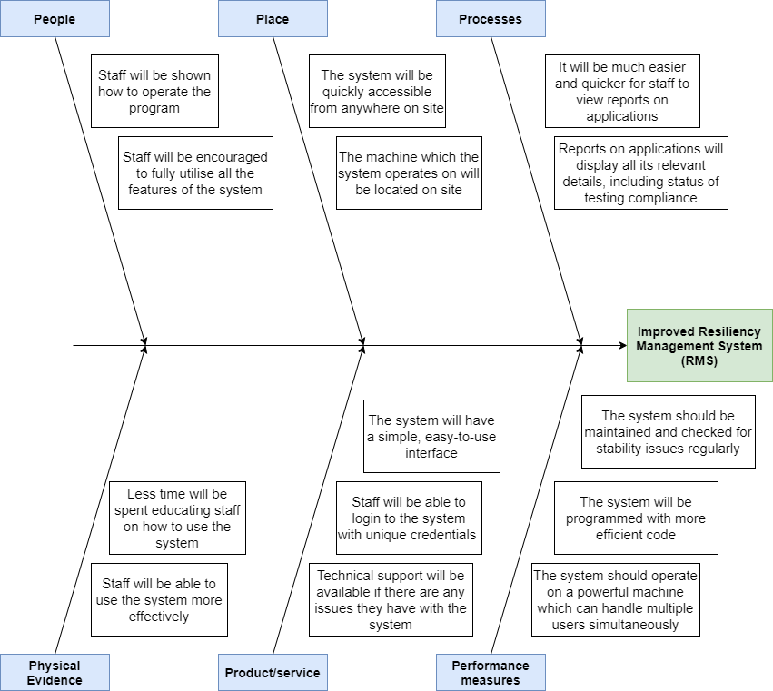
6 P’s Cause & Effect Diagram (Fishbone)
Notes:
Suits smaller problems

